Slide 1
Boosting a Genetic Fuzzy Classifier
BISC Seminar
July 23rd, 2001
Frank Hoffmann
Royal Institute of Technology, Stockholm

Slide 2
Classification Problem
Assume a set s of N instances x_{i} ∈ X each belonging to one of M classes { c¹,…c^{M} }.
The training set consists of pairs (x_{i},c_{i}).
A classifier C assigns a classification
C(x) ∈ { c¹,…c^{M} } to an instance x.
The classifier learned in trial t is denoted C^{t} while C* is the composite (bagged or boosted) classifier.

Slide 3
Example : Perceptron
Possible classes : { , }
Perceptron if w x₁ – x₂ + a > 0
otherwise
x
o
x
o
x₂
S
x
C :
x₂ = w x₁ + a
x
x
x
o
x
o
o
o
o
x₁

Slide 4
Bagging & Boosting
Bagging and Boosting aggregate multiple hypotheses generated by the same learning algorithm invoked over different distributions of training data [Breiman 1996, Freund & Schapire 1996].
Bagging and Boosting generate a classifier with a smaller error on the training data as it combines multiple hypotheses which individually have a larger error.

Slide 5
Bagging
From the overall training S set randomly sample (with replacement) T different training sets S₁,...,S_{T} of size N.
For each sample set S_{t} train a classifier C^{t} .
To an unseen instance x assign the classification c*(x) that receives the majority of votes c_{t}(x) among the classifiers C^{t}
C*
c*(x) = maxcnt_{t} c_{t}(x)
x
c₁(x)
…
C¹
C²
c₂(x)
C^{T}
c_{T}(x)
train
train
train
…
S₁
S₂
S_{T}

Slide 6
Bagging
Bagging requires ”instable” classifiers like for example decision trees or neural networks
”The vital element is the instability of the prediction method. If perturbing the learning set can cause significant changes in the predictor constructed, then bagging can improve accuracy.” (Breiman 1996)

Slide 7
Boosting
Instead of drawing a succession of independent samples from the original training set boosting maintains a weight w_{i} for each instance (x_{i}, c_{i}).
The higher the weight w_{i}, the more the instance x_{i} influences the next classifier learned.
At each trial, the weights are adjusted to reflect the performance of the corresponding classifier, with the result that the weight of misclassified instances is increased.

Slide 8
Boosting
Construct a classifier C^{t} from the given instances under the distribution w^{t}.
Adjust the weights according to classification error ε^{t} of classifier C^{t}.
train classifier
Set of
weighted
instances
Classifier C^{t}
adjust weights

Slide 9
Boosting
Similar to bagging the final classifier C* aggregates the learned classifiers C^{t} by voting, but each classifier’s vote is function of its accuracy.
Let w_{i}^{t} denote the weight of an instance x_{i} at trial t, for every x_{i}, w_{i}¹ = 1/N. The weight w_{i}^{t} reflects the probability of occurrence of the instance x_{i} in the sample set S^{t}.
At each trial t = 1,…,T a classifier C^{t} is constructed from the given instances under the distribution w^{t}.
Notice, that many learning algorithms such as fuzzy rule learners and decision tree learners are able to handle weighted, fractional examples.

Slide 10
Boosting
The error of the classifier C_{t} is measured with respect to the weights
ε_{t} = Σ_{i} _{Ct(xi) ≠ ci} w_{i}^{t} / Σ_{i} w_{i}^{t}
Multiply the weights w_{i}^{t} of correctly classified instances by the factor
β^{t} = ε_{t}/(1-ε_{t})
w_{i}^{t+1} = w_{i}^{t} β^{t} if C_{t}(x_{i}) = c_{i}
w_{i}^{t+1} = w_{i}^{t} if C_{t}(x_{i}) ≠ c_{i}

Slide 11
Boosting
The boosted classifier C* is obtained by summing the votes of the classifiers C¹,C²,…,C^{T} where the vote of each classifier C^{t} is worth log(1/β_{t}) units.
c*(x) = argmax_{cm} Σ_{ct(x)=cm} log(1/β_{t})
x
C*
c₁(x)
…
C¹
C²
c₂(x)
C^{T}
c_{T}(x)
train
train
train
…
S,w¹
S,w²
S,w^{T}

Slide 12
Fuzzy Classification Rules
R_{k} : if X_{k} is A_{k1} and … X_{M} is A_{kM} then Y = c_{k}
X₂
x
x
o
x
o
o
x
x
A_{k2}
o
o
A_{k1}
X₁

Slide 13
Classification of Instances
Instance: x_{i} ={ x_{i1},…,x_{iM}}
Rule activation:
μ_{Rk}(x_{i}) = min μ_{Akm}(x_{im})
Instance classification :
c(x_{i})= argmax_{cm} Σ_{Rk\ ci=cm} μ_{Rk}(x_{i})

Slide 14
Genetic Fuzzy Classifier
generate
fuzzy rule
training
instances
genetic-fuzzy
rule learner
add rule
fuzzy rule
base
remove training instances
that are “sufficiently” covered

Slide 15
Iterative Rule Learning (IRL)
The iterative rule learning approach (IRL) [Cordon, Herrera 1997] consists of a
  Rule generation stage to obtain a preliminary set of rules.
  Post-processing stage refines the rule base to improve cooperation.

Slide 16
Iterative Rule Learning
Iterative covering method
  Invoke a fuzzy rule learner (e.g. Wang-Mendel, Higgins-Goodman, neuro-fuzzy, genetic fuzzy) to generate a fuzzy rule that correctly classifies some of the training instances.
  Add the new rule to the rule base and remove those instances from the training set that are “sufficiently” covered by the current set of rules.
  Invoke the rule learner until the training set becomes empty.

Slide 17
Iterative Covering Method
R₁ : if X₁ is A₁₁… then Y =
x
R₂ : if X₁ is A₁₂… then Y =
o
X₂
X₂
X₂
X₂
x
x
x
x
x
x
x
o
x
o
o
o
o
o
o
o
o
o
o
o
x
o
x
x
A₁₂
x
A₁₂
o
o
o
o
o
o
o
o
A₁₁
X₁
A₁₁
X₁
X₁
X₁

Slide 18
Genetic Fuzzy Rule Learner
Descriptive fuzzy rule base
  Fuzzy rules employ a common definition of linguistic variables and use labels A_{ij} to refer to a discrete set of linguistic fuzzy sets.
R_{i} : if X₁ is A_{i1} and X₂ is A_{i2} … then …
Approximate fuzzy rule base
  Each fuzzy rule employs its own definition of parameterized fuzzy membership functions (e.g. trapezoidal fuzzy sets {a_{ij},b_{ij},c_{ij},d_{ij}}).
R_{i} : if X₁ is {a_{i1},b_{i1},c_{i1},d_{i1}} and X₂ is {a_{i2},b_{i2},c_{i2},d_{i2}} … then …

Slide 19
Genetic Encoding of Fuzzy Sets
The object vector in the evolution strategy encodes the characteristic points {a_{ij},b_{ij},c_{ij},d_{ij}} of a trapezoidal fuzzy set A_{ij} by means of {a_{ij},δ¹_{ij},δ²_{ij},δ³_{ij}} .
a_{ij}
δ¹_{ij}
δ²_{ij}
δ³_{ij}
μ
A_{ij}
a_{ij}
b_{ij}
c_{ij}
d_{ij}
x

Slide 20
Genetic Encoding of Fuzzy Rules
A fuzzy rule is encoded by the concatenation of the antecedent fuzzy set parameters and the class in the conclusion {a_{i1},δ¹_{i1},δ²_{i1},δ³_{i1} , a_{i2},δ¹_{i2},δ²_{i2},δ³_{i2},…, c_{i} } .
An additional bit-string {s_{i1},s_{i2},…,s_{iM}} denotes the presence (s_{ij}=1) or absence (s_{ij}=0) of fuzzy variables in the antecedent, to allow for general, compact fuzzy rules such as
R_{i} : if X₂ is {a_{i2},b_{i2},c_{i2},d_{i2}} and X₄ is {a_{i4},b_{i4},c_{i4},d_{i4}} then …

Slide 21
Evaluation of Fuzzy Rules
The evolution strategy evolves a population of individual fuzzy rules according to the following optimization criteria
  High frequency value: favors fuzzy rules that cover a large number of correct instances (c_{i}=c_{k})
  f₁(R_{k}) = Σ _{i\ci=ck} μ_{Rk}(x_{i}) / Σ _{i\ci=ck} 1
  Rule consistency: favors fuzzy rules for which the fraction of incorrectly classified instances (c_{i}≠c_{k}) covered by the rule antecedent is small
  f₂(R_{k}) = Σ _{i\ci≠ck} μ_{Rk}(x_{i}) / Σ_{i} μ_{Rk}(x_{i})

Slide 22
Boosted Genetic Fuzzy Classifier
generate
fuzzy rule
training
instances
genetic-fuzzy
rule learner
add rule
fuzzy rule
base
classify current
distribution of
training instances
adjust
distribution
of training
instances
adjust
fuzzy rule
strength
boosting
algorithm

Slide 23
Related Approaches
Sanchez et al. [Junco, Sanchez 2000] proposed a newer version of Adaboost to induce fuzzy classification rules.
Confidence based classification rules
If X₁ is A_{i1} and X₂ is A_{i2} …
then truth(c1) = α₁ and truth(c₂)=α₂ …
Descriptive fuzzy rules
Slightly different version of Adaboost for confidence based classifiers [Schapire et al. 2001]

Slide 24
Boosting of Fuzzy Rules
The error of the classifier R_{t} is measured with respect to the weights w_{i}^{t} and the degree of membership μ_{Rt}(x_{i}) of an instance x_{i}
ε_{t} = Σ_{i} _{ct ≠ ci} μ_{Rt}(x_{i}) w_{i}^{t} / Σ_{i} μ_{Rt}(x_{i}) w_{i}^{t}
Multiply the weights w_{i}^{t} of correctly classified instances by the factor
β^{t} = ε_{t}/(1-ε_{t})
w_{i}^{t+1} = w_{i}^{t} β^{t μR}t^{(xi)} if c_{t} = c_{i}
w_{i}^{t+1} = w_{i}^{t} if c_{t} ≠ c_{i}

Slide 25
Evaluation of Boosted Fuzzy Rules
The evolution strategy employs the same optimization criteria for fuzzy rules R_{t} as in the IRL approach but takes the weight of training instances w_{i}^{t} into account when computing the rule fitness.
  High frequency value:
  f₁(R_{t}) = Σ _{i\ci=ck} μ_{Rk}(x_{i}) w_{i}^{t} / Σ _{i\ci=ck} w_{i}^{t}
  Rule consistency:
  f₂(R_{t}) = Σ _{i\ci≠ck} μ_{Rk}(x_{i}) w_{i}^{t} / Σ_{i} μ_{Rk}(x_{i}) w_{i}^{t}
  Overall fitness:
  f(R_{t}) = 0 if f₂ > k_{max}
  = f₁ * (1 – f₂/k_{max}) if f₂ ≤ k_{max}

Slide 26
Aggregation of Boosted Fuzzy Rules
The aggregated boosted classifier C* classifies a new instance x by accumulating the votes of the individual classifiers R_{t} weighting them with the classifier accuracy log(1/β^{t}) and the membership degree μ_{Rt}(x) of x to rule R_{t}
C*(x) = argmax _{cm} Σ _{Rt} \ _{cm=ct} log(1/β^{t}) μ_{Rt}(x)

Slide 27
Parameter Settings
Genetic rule learner (inner loop)
  (20,200)-evolution strategy
  Initialize first generation of fuzzy rules with fuzzy sets generated from a pair of training instances that belong to the same class
  40 generations
  k_{max} ∈ [0.2…0.7] (rule consistency)
Boosting algorithm (outer loop)
  Stopping criteria
    Fixed number of rules
    Sufficient coverage of training examples

Slide 28
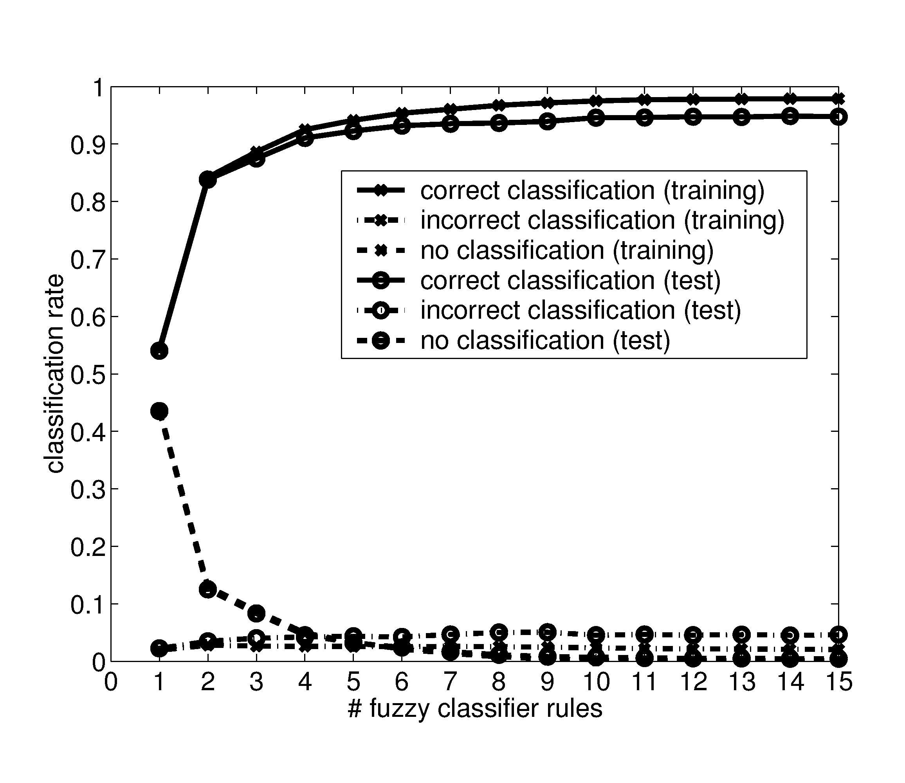
Results
Evolution of training and test set error with the number of fuzzy rules for cancer data set.

Slide 29
Results
2-class data sets: pima, cancer, gauss
multi-class data sets: glass, image, gauss-5
50% training data, 50% test data
average classification error over 10 runs
Results for other classifiers taken from [Junco, Sanchez et al. 2001]
Linear (LIN) and quadratic (QUA) discriminant analysis, neural networks (NEU), nearest neighbors (NN), descriptive fuzzy rule based methods Wang-Mendel (WM) [Wang 1992], Ishibuchi (HL) [1992], Pal and Mandal (PM) [Pal 1992] and Iterative Genetic Learning (GIL) [Del Jesus 1999], descriptive fuzzy Adaboost (ABD) [Junco et al 2001]

Slide 30
Classification Errors
 | LIN | QUA | NEU | NN | WM | HL | PM | GIL | ABD | ABA
Pima | 0.227 | 0.252 | 0.255 | 0.289 | 0.287 | 0.301 | 0.464 | 0.269 | 0.241 | 0.252 #3
Cancer | 0.044 | 0.051 | 0.047 | 0.048 | 0.129 | 0.058 | 0.087 | 0.099 | 0.040 | 0.049 #5
Gauss | 0.239 | 0.190 | 0.200 | 0.267 | 0.477 | 0.304 | 0.457 | 0.205 | 0.213 | 0.187 #1
Glass | 0.403 | - | 0.439 | 0.354 | 0.453 | 0.503 | 0.647 | 0.363 | 0.359 | 0.359 #2
Image | 0.084 | - | 0.090 | 0.049 | 0.329 | 0.833 | 0.755 | 0.130 | 0.136 | 0.100 #4
Gauss5 | 0.317 | 0.317 | 0.323 | 0.413 | 0.539 | 0.344 | 0.931 | 0.338 | 0.327 | 0.348 #7

Slide 31
Conclusions
Iterative rule learning approach for fuzzy classifiers.
Genetic fuzzy rule learner generates the fuzzy rule that best matches the current distribution of training instances.
The boosting algorithm adjusts the weight of training instances and thereby implicitly promotes cooperation among fuzzy rules.
Post-processing stage to refine fuzzy rule base becomes obsolete.

